Slide 1

Real-life Applications of Hypothesis Testing

Slide 2
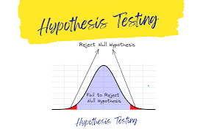
What is Hypothesis Testing?
Hypothesis testing is like a detective tool for data—it helps uncover whether patterns we observe are meaningful or just random flukes. By comparing assumptions (like "this new method changes nothing") against real-world evidence, it guides decisions across healthcare, business, and even environmental conservation.

Slide 3
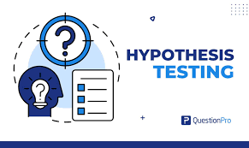
Hypothesis testing in different way
Imagine you're trying a new recipe for chocolate chip cookies. You've tweaked the ingredients, and you think they're going to be amazing. Hypothesis testing is like a structured way of figuring out if your tweaks actually made a difference.
You start with a guess – maybe the new recipe doesn't make better cookies (this is our null hypothesis – the status quo). Then, you bake a batch and have your friends taste-test them. You collect data – how much did they like them? Hypothesis testing helps you determine if the taste-test results are strong enough to say, "Okay, the new recipe does make better cookies!" (This is accepting the alternative hypothesis).

Slide 4

Key Steps in Hypothesis Testing
Formulate hypotheses: Define the null (H₀) and alternative (H₁) hypotheses.
Select significance level: Typically, α = 0.05 or 5%.
Choose a statistical test: e.g., t-test, z-test, or chi-square test.
Calculate test statistic and p-value: Determine the likelihood of observing the data under H₀.
Draw conclusions: Reject H₀ if p-value < α, supporting H₁

Slide 5

Real-Life Applications & Examples
This Hypothesis Testing is commonly used in many areas to help understand real-life situations better and make smart decisions. It's like a tool that helps us understand things we experience every day and figure out the best choices to make.

Slide 6

🏥 Healthcare: Saving Lives with Data
Scenario: Testing a new blood pressure drug vs. an existing one.
H₀: New drug = Old drug (no difference).
H₁: New drug lowers blood pressure more.
Method: Clinical trial with two patient groups → t-test.
Impact: If p < 0.05, the drug could reach pharmacies, improving treatment options.

Slide 7

🛍️ Retail: Boosting Customer Joy
Scenario: A café introduces a new dessert and wants to know if it’s more popular.
H₀: New dessert rating = Old dessert rating.
H₁: New dessert has higher ratings.
Method: Survey 100 customers → paired t-test.
Impact: If results favor H₁, the dessert stays; if not, the menu gets revised.

Slide 8

🌱 Agriculture: Growing Better Crops
Scenario: A farmer tests if organic fertilizer increases wheat yield.
H₀: Fertilizer A = Fertilizer B (no yield difference).
H₁: Organic fertilizer produces more wheat.
Method: Split fields into test plots → ANOVA.
Impact: Adopting better fertilizers can reduce costs and improve sustainability.

Slide 9

📈 Marketing: Smarter Ad Spending
Scenario: A company tests if Instagram ads increase sales.
H₀: Sales after ads = Sales before.
H₁: Sales spike post-campaign.
Method: Compare sales data → chi-square test.
Impact: Redirecting budgets to effective platforms maximizes ROI.

Slide 10

🏭 Manufacturing: Fewer Defects, Higher Quality
Scenario: A factory tests a new assembly line technique.
H₀: Defect rate remains 5%.
H₁: Defect rate drops below 5%.
Method: Monitor output for a month → z-test.
Impact: Reducing defects saves costs and boosts customer trust.

